Slide 1
Biology
Unit 3 Matter and Energy in Living Systems
Lesson 1: Photosynthesis
Notes:
The learning experiences in this unit prepare students for the mastery of
Lesson Objective: Use models to illustrate and explain how energy is transferred in the process of photosynthesis.

Slide 2

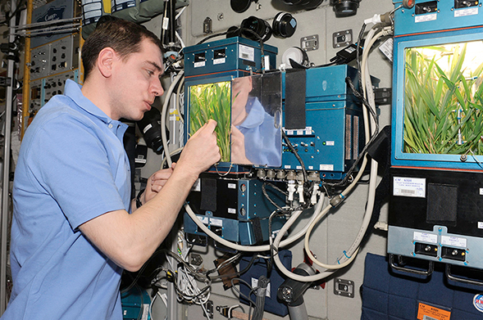
Can You Explain It?
Unit 3 Lesson 1
Imagine you are colonizing another planet, and you want to grow plants there as a food source. What do you need to bring, and what questions would you ask about the planet in order to refine your list?
A cosmonaut checks the progress of a plant growth experiment in a module of the International Space Station.

Slide 3
Matter and Energy in Photosynthesis
Unit 3 Lesson 1
Living systems take in energy and matter and convert them to forms they can use.
Plants, for example, are producers that capture light energy and convert it to chemical energy to carry out cell processes within the plant.
Plants, algae, and some bacteria use a process called photosynthesis to capture and transform light energy from the sun and store it in high-energy sugar molecules.

Slide 4
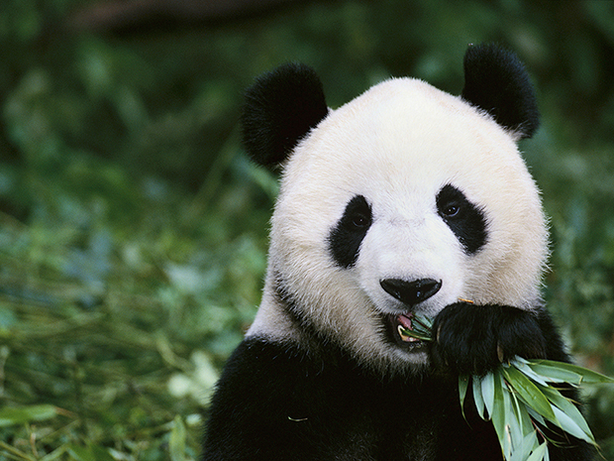
Matter and Energy in Photosynthesis
Unit 3 Lesson 1
How is energy transferred from the sun to the panda?

Slide 5
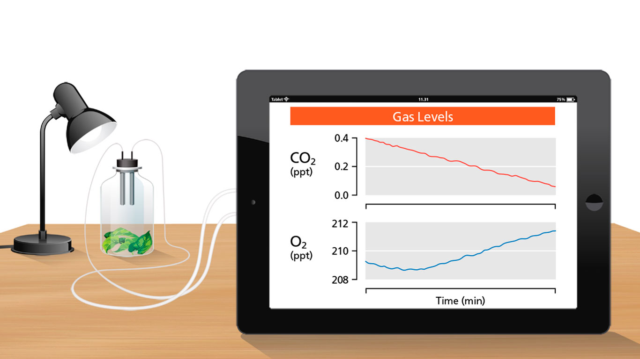
Matter and Energy in Photosynthesis
Unit 3 Lesson 1
This setup shows a plant in a closed system. Sensors are measuring carbon dioxide and oxygen concentrations in the chamber. The gas concentrations are shown in parts per thousand.

Slide 6
Matter and Energy in Photosynthesis Energy and Matter
Unit 3 Lesson 1
MODEL
Draw a plant and label the inputs and outputs of photosynthesis. Where should the labels for enzymes and light be placed?

Slide 7
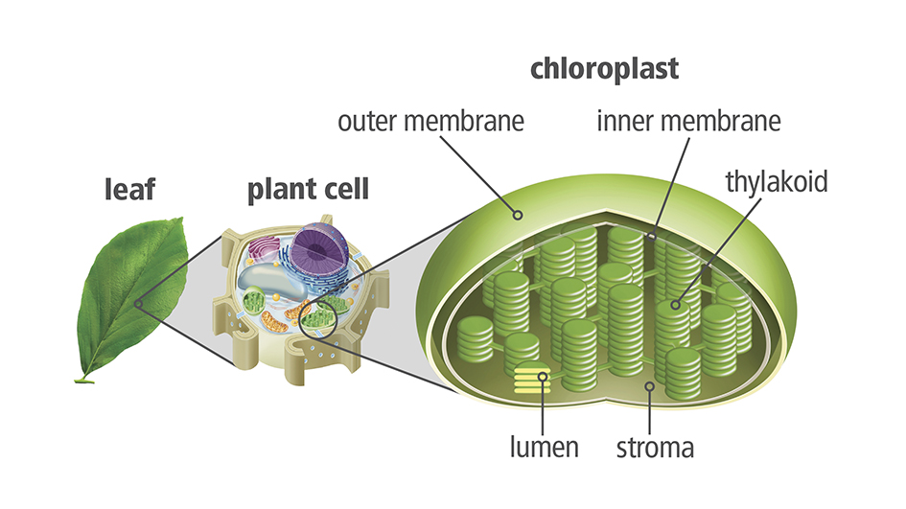
Matter and Energy in Photosynthesis
Unit 3 Lesson 1
In plant cells, light absorption and photosynthesis take place inside an organelle called a chloroplast.

Slide 8
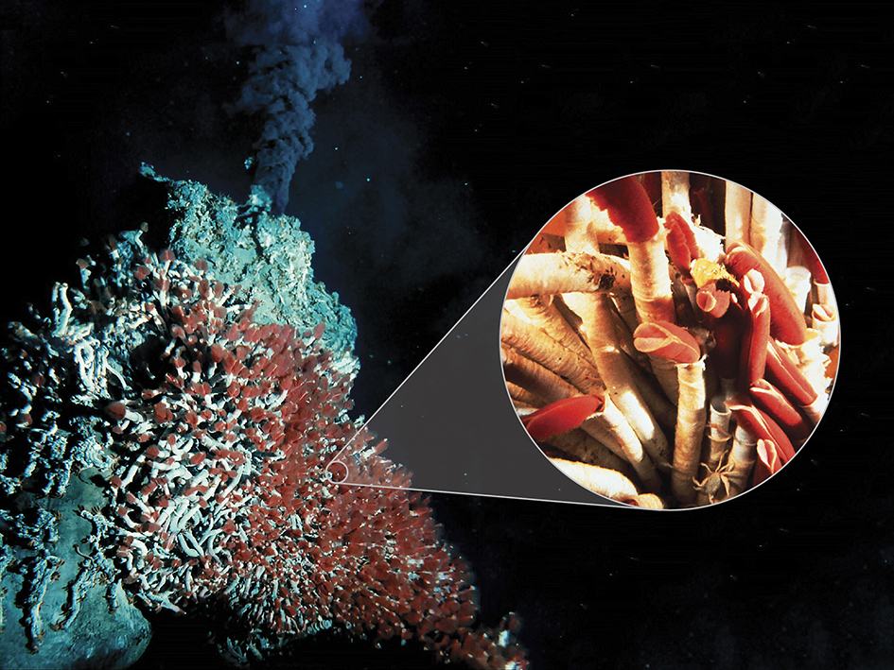
Matter and Energy in Photosynthesis
Unit 3 Lesson 1
Chemosynthesis is the process of using chemical energy to make sugars from carbon dioxide for energy storage.

Slide 9
Matter and Energy in Photosynthesis
Unit 3 Lesson 1
MODEL Make a graphic organizer to compare the inputs and outputs for chemosynthesis and for photosynthesis.

Slide 10
Transforming Light Energy into Chemical Energy
Unit 3 Lesson 1
Chloroplasts in cells are like solar-powered chemical factories.
They transfer light energy to energy-carrying molecules called ATP and NADPH.
In plant cells, they are used to convert carbon dioxide into sugars.

Slide 11
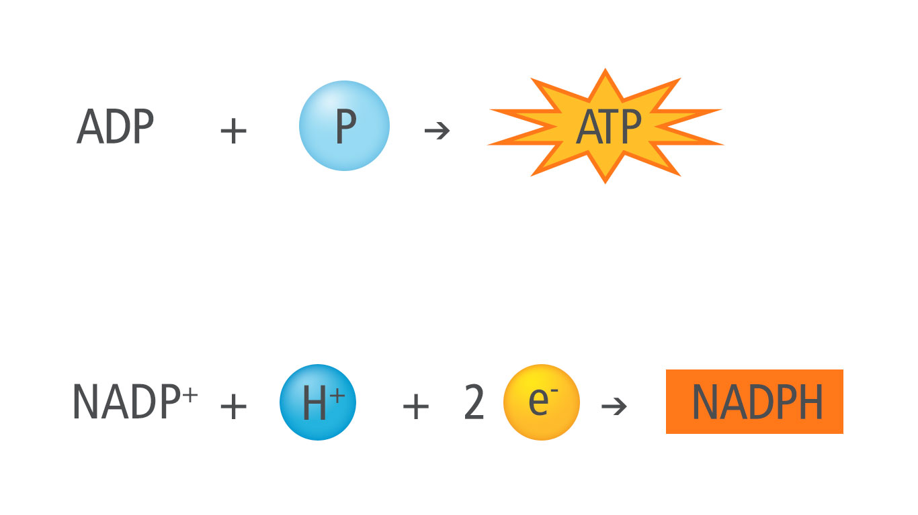
Transforming Light Energy into Chemical Energy
Unit 3 Lesson 1
Two energy-carrying molecules are used in photosynthesis. ATP stores energy in a phosphate-phosphate bond, and NADPH carries high-energy electrons.

Slide 12
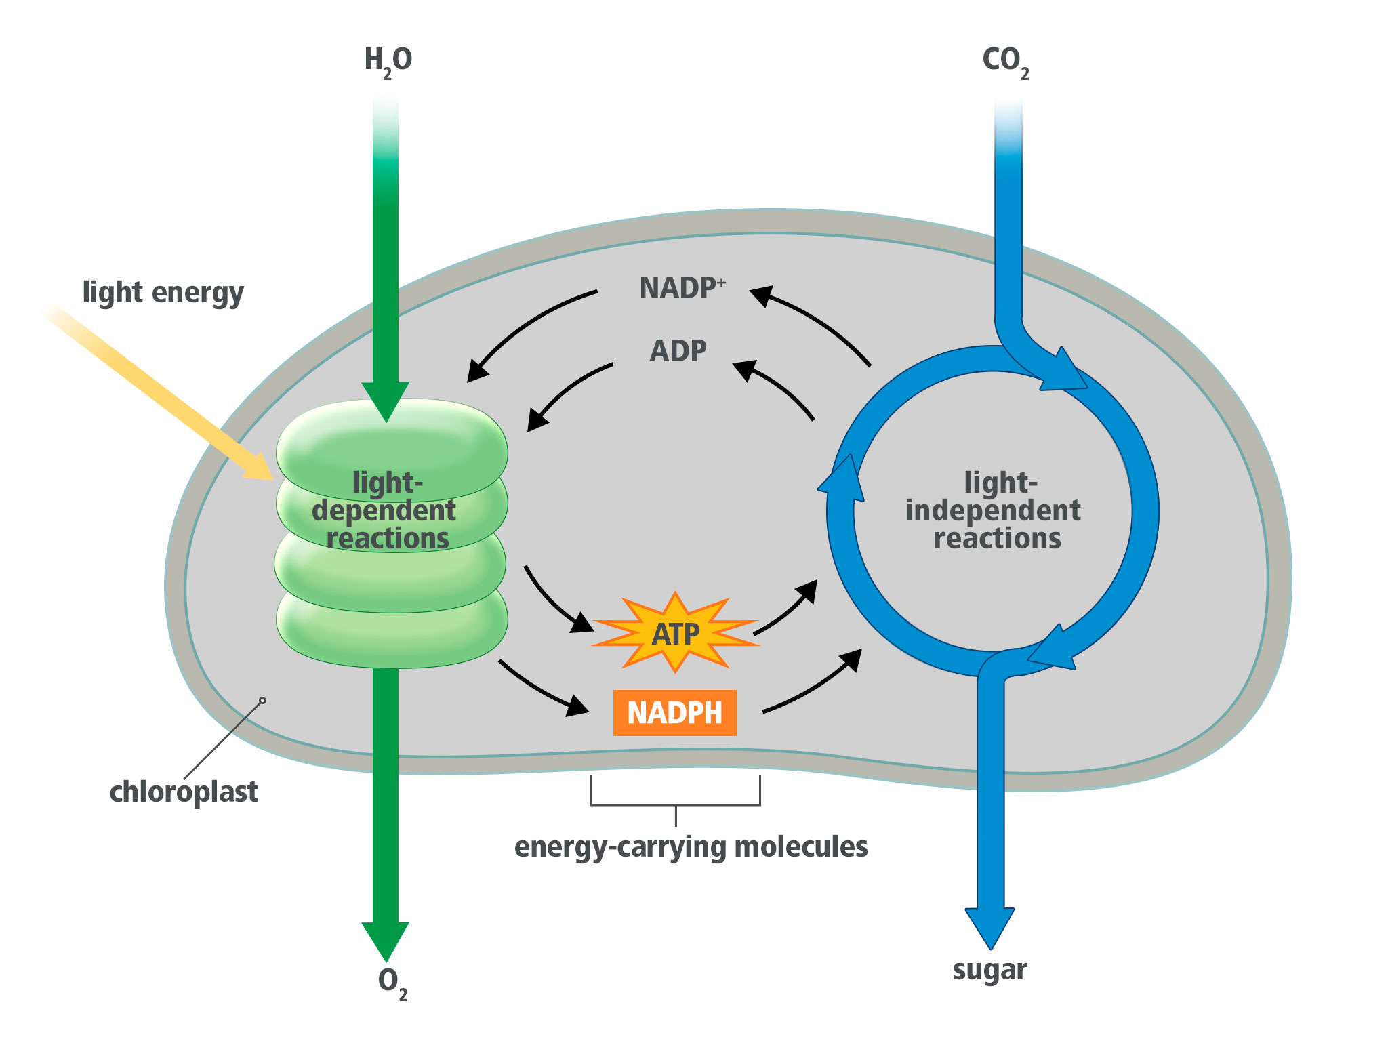
Transforming Light Energy into Chemical Energy
Unit 3 Lesson 1
How does alternating between light-dependent and light-independent reactions help the cell conserve energy and matter? Cite evidence from the diagram to support your answer.

Slide 13
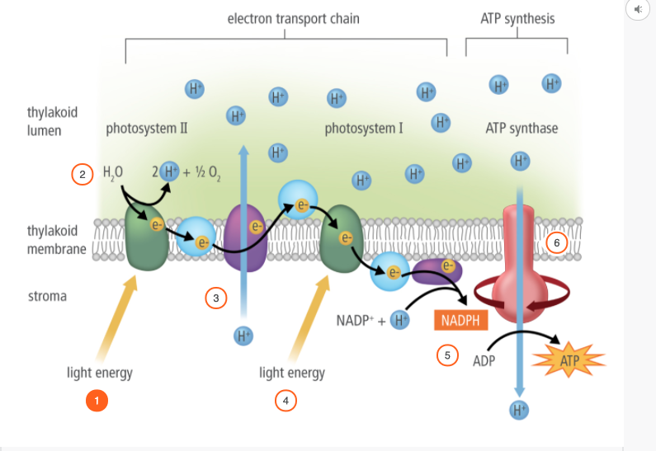
Transforming Light Energy into Chemical Energy
Unit 3 Lesson 1

Slide 14
Transforming Light Energy into Chemical Energy
Unit 3 Lesson 1
MODEL
Develop a model to Illustrate how photosynthesis transforms light energy into chemical energy. In your model, show how energy from sunlight is converted to energy in sugars, and identify the inputs and outputs for each stage of the process.

Slide 15
Unit 3 Lesson 1
Continue Your Exploration
Choose one of the paths below to continue your exploration:
Investigating Light Sources and Photosynthesis
The Color of Plants on Other Plants
Variation in Photosynthesis

Slide 16
Can You Explain It?
Unit 3 Lesson 1
Refer to the notes in your Evidence Notebook to help you explain whether or not a robot fits the criteria of a living system. Consider the following questions when developing your explanation:
What inputs do plants need to carry out photosynthesis, and how might you provide these on another planet?
What outputs do plants produce from photosynthesis, and how do these benefit humans?
How do plants transfer energy from light to sugar molecules?
What questions would you ask about the planet to refine your list of necessary materials?

Slide 17
Image Credits
Unit 3 Lesson 1
red tubeworms & hydrothermic vent ©Dr. Deborah Kelley, University of Washington and ®CSSF ROV ROPOS; tubeworm colony ©Ralph White/Corbis; cosmonaut checking plant growth ©NASA Kennedy Space Center

